Slide 1
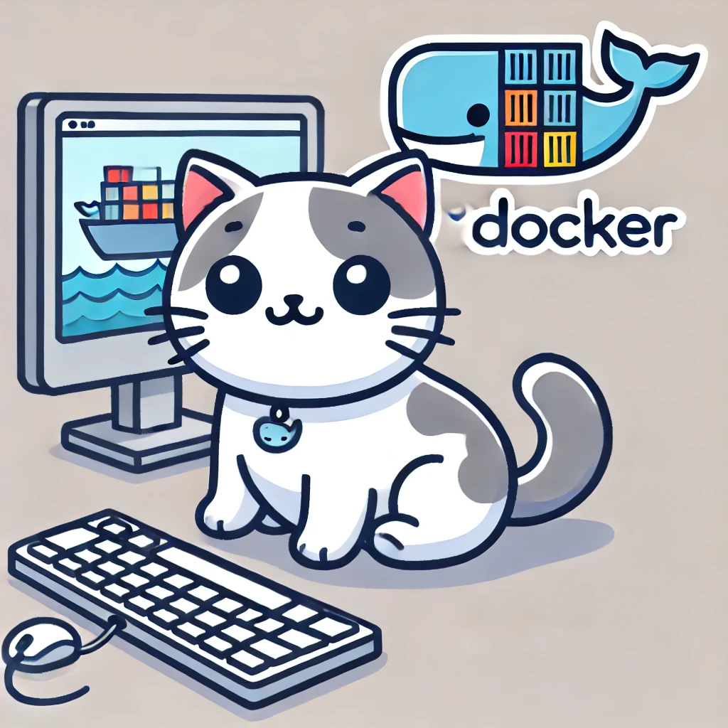
Studying Docker with Jimmy

Slide 2
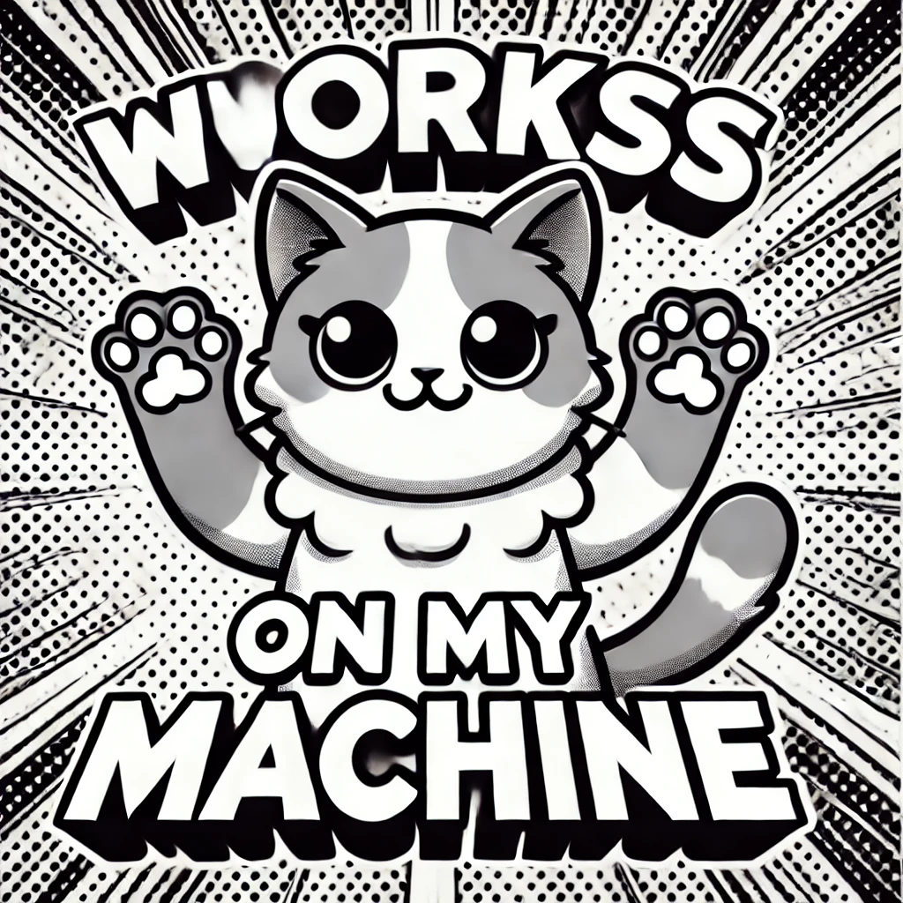

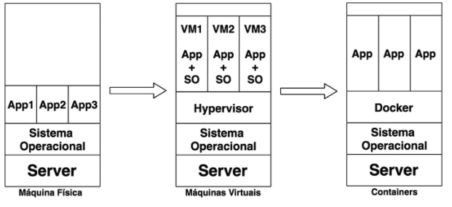
Container
Whats is?
It is the grouping of an application along with its dependencies, sharing the host machine's resources. It provides better performance compared to virtual machines since, as mentioned, it shares the kernel.
Each container has a very lightweight image that contains only what is necessary for the application to run. The container becomes portable, regardless of the environment, as long as a container service is installed on the operating system, whether it's Windows, Linux, or macOS. Containers eliminate the phrase: "It works on my machine."

Slide 3

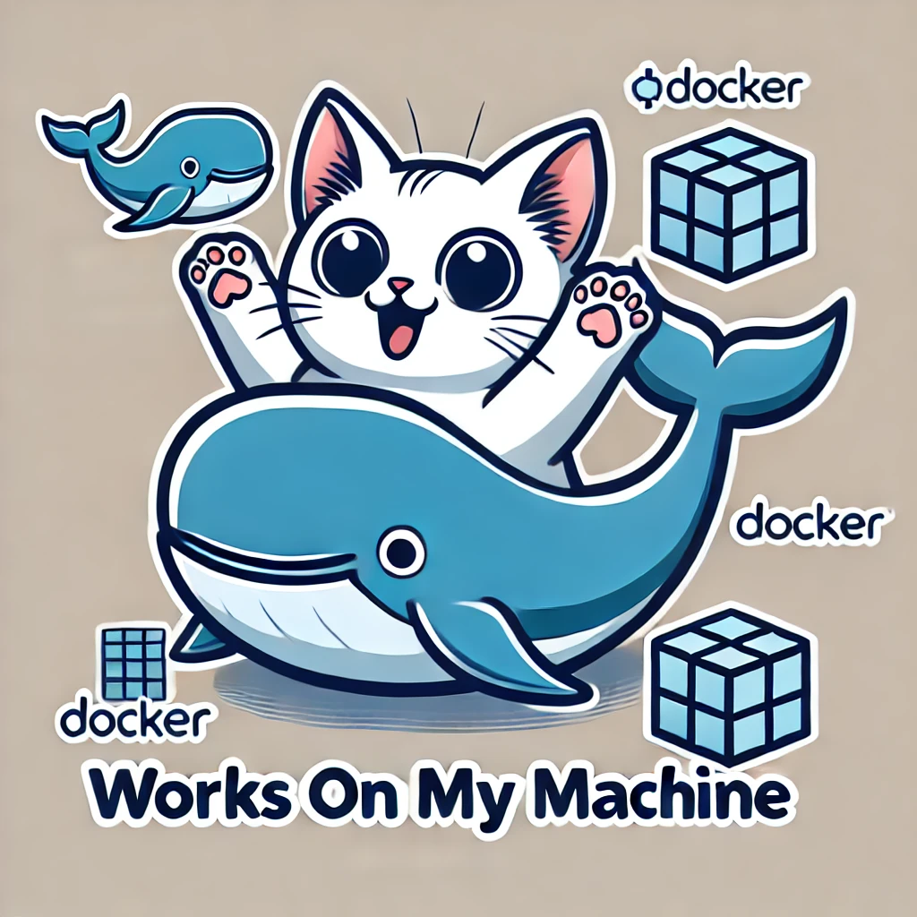
Docker
Creation:
Docker began being planned in 2008 with the foundation of dotCloud, a company that provided platform-as-a-service. The major breakthrough came in 2013 when the platform's code became open-source, bringing Docker to fame! Today, Docker is already used by various cloud platforms in the market.
Docker has a public image repository called Docker Hub, where many companies contribute by uploading their images whenever their software is updated. Docker images can be either public or private. Docker offers numerous benefits, especially for developers and system administrators. It allows maintaining the configuration state as declared and enables the use of a single image for both development and production environments.

Slide 4

Pratical Example
docker run -it -p 80:80 --name docker_with_jimmy vitorlavor/presentation_docker

